Slide 1
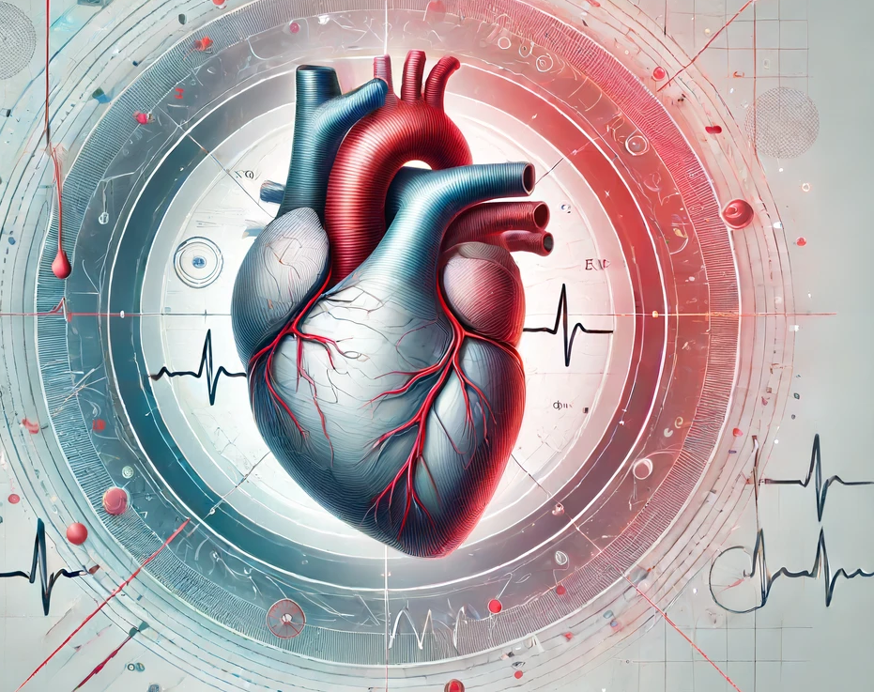
Exploring the Primary Risk Factors Driving Ischemic heart disease

Slide 2
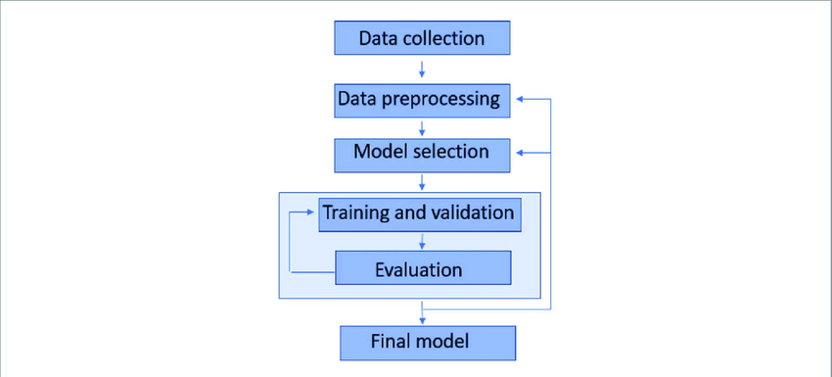
Understanding Machine Learning
Definition: Machine Learning (ML) is a field of artificial intelligence that enables computers to learn from data and make decisions based on it. Unlike traditional programming, where rules are explicitly programmed, ML algorithms adjust their parameters based on patterns in the data, essentially 'learning' from it.
How it works:
Data Input: Everything starts with data—examples that include both the inputs and the expected outputs.
Model Training: An algorithm uses this training data to learn relationships between inputs and outputs. This process involves adjusting the model’s parameters to minimize errors in its predictions.
Prediction and Improvement: Once trained, the model can make predictions on new, unseen data. Over time, as it receives feedback, the model can be refined and improved.

Slide 3
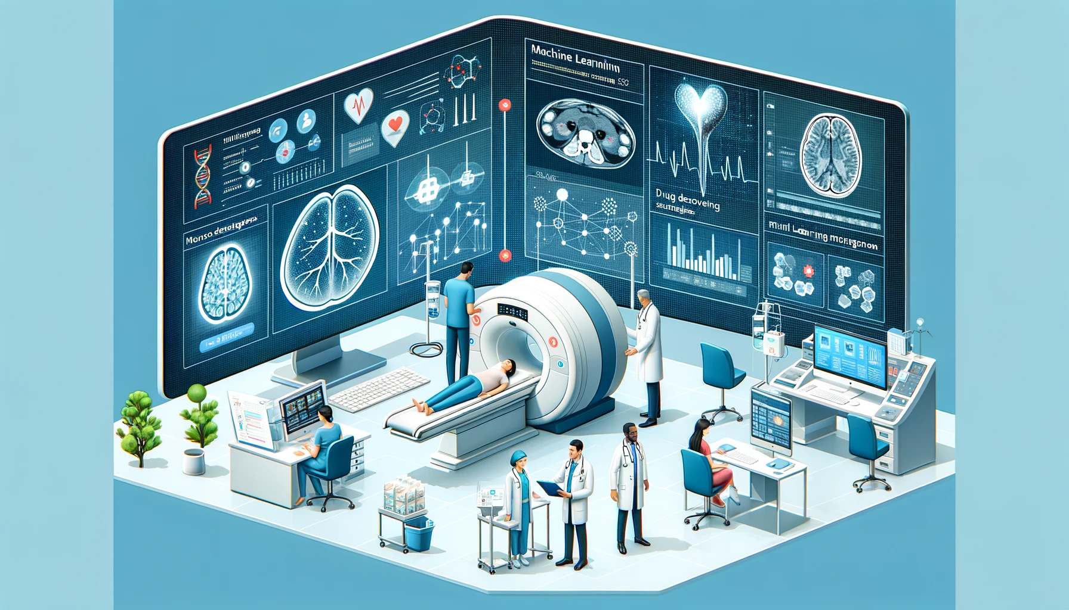
Machine Learning in Healthcare
Machine learning has become a pivotal technology in healthcare, offering innovative ways to enhance patient care, improve diagnostic accuracy, and streamline operations.
There some uses of ml in healthcare :
Early Detection: ML models are used to detect diseases at earlier stages when they are more treatable. For example, ML algorithms can analyze images from MRIs or X-rays to identify signs of diseases such as cancer far earlier than traditional methods.
Predictive Analytics: Utilize historical patient data to predict health outcomes, helping in preventive care and personalized treatment plans.
Accelerating Research: Speeding up the processes of drug discovery and validation, reducing costs, and improving success rates in clinical trials.

Slide 4
Ischemic heart disease
Background: Coronary artery disease (CAD)
CAD limits blood flow in your coronary arteries, which deliver blood to your heart muscle. Cholesterol and other substances make up plaque that narrows your coronary arteries. Heart attack, Is the most common CAD symptom.
If you have CAD, you have a higher risk of heart damage and other cardiovascular problems. Ischemia, or reduced blood flow, is one of the many possible complications of CAD.
Ischemic heart disease refers to heart weakening caused by reduced blood flow to your heart. Typically, this reduced blood flow is the result of CAD.
Like other types of CAD, you may not have any symptoms at first. For some people, the first sign of ischemic heart disease is a heart attack. And this is one of the reasons that we picked up this research. This disease are sometimes called “the silent killer”, because you can first notice the problem, when its just too late.
As IHD worsens, you may experience chest pain, dizziness or fainting, shortness of breath and swelling in your feet and muscles.

Slide 5
Ischemic heart disease
Some ways to diagnose IHD:
1. Ultrasound test
2. EKG
3. Imaging studies such as chest X-Ray, CT scan, or MRI
4. Stress test
5. Wearable monitor
Ischemic Heart disease (IHD) is the single largest cause of death worldwide, causing around 7 million deaths per year, accounting of 12% of total global death. India and China together had over 2 million deaths per year, of IHD.

Slide 6
Ischemic heart disease – Personal Point of view
Personally , my father suffered from IHD, disease that discovered 5 years ago, while cycling.
my father had an aggressive heart attack, which endangered his life.
What surprise me the most is the fact that my father was an athlete, does not smoke or drink, and maintains healthy diet, so these facts shattered my previous opinion about the disease, which is why we chose this topic.

Slide 7

The UK Biobank Resource
The UK Biobank is a large-scale biomedical database and research resource, containing in-depth genetic and health information from approximately 500,000 individuals across the UK.
Purpose: Established to provide valuable data for researchers studying the genetic and environmental factors that contribute to the development of diseases and health conditions.
Data Collection: Participants have provided samples and detailed health information, which made available to approved researchers worldwide.
Significance: The extensive data allows for advanced research on complex diseases such as CAD, utilizing both genetic and lifestyle information to explore risk factors and outcomes.

Slide 8
Our Research Goals
Our study leverages the extensive data available in the UK Biobank to investigate a comprehensive array of risk factors for ischemic heart disease. We aim to deepen the understanding of both well-established and emerging risk factors by examining demographic, genetic, and lifestyle variables.
Objectives:
Identify: Systematically identify and categorize key risk factors.
Analyze: Employ advanced machine learning techniques to analyze the impact of these risk factors on IHD.
Innovate: Discover less obvious risk factors that could offer new insights into the prevention and management of IHD.
Our ultimate goal is to generate actionable insights that can enrich further academic research and potentially inform public health strategies. By identifying and elucidating lesser-known risk factors, we aim to empower individuals with knowledge that could influence lifestyle choices and improve health outcomes.

Slide 9
Defining Our Research Question
The primary objective of our research is to answer the following pivotal question:
What are the key demographic, genetic, lifestyle, and other risk factors for ischemic heart disease, and how do these factors influence the disease's progression?
This question aims to:
Bridge Gaps: Identify areas where existing research on ischemic heart disease is lacking, particularly in understanding the interplay of lifestyle factors.
Focus on Impact: Determine the impact of identified risk factors on the progression of ischemic heart disease.
Drive Innovation: Explore under-researched or novel risk factors that could lead to groundbreaking approaches in disease prevention and management.

Slide 10
Preparing the UK Biobank Data
Our study utilizes data harvested from the UK Biobank to accurately represent the diverse factors influencing ischemic heart disease. The data collection process involves:
Feature Identification:
Comprehensive Assessment: Identify and select relevant demographic, genetic, and lifestyle features known to influence ischemic heart disease.
Data Integrity: Ensure the robustness and reliability of the data points chosen for analysis.
Cohort Selection:
Targeted Sampling: Extract a subset of individuals who exhibit the identified features, creating a focused group for detailed study.
Inclusive Criteria: Include diverse population segments to ensure the study’s findings are generalizable.
Research Group Balancing:
Reflect Real-World Statistics: Aim for a research group composition that mirrors the real-world prevalence of ischemic heart disease. Maintain an appropriate ratio of affected to non-affected individuals to support statistical analysis and relevance.

Slide 11
Data pre-processing
Following the initial data collection, our study progresses into the critical phase of data preprocessing, ensuring the data's suitability for in-depth analysis. This stage includes:
Feature Handling:
Categorical Variables: Convert categorical data into numerical codes or dummy variables to facilitate machine learning algorithms.
Continuous Variables: Assess the distribution of continuous variables and apply transformations if necessary to normalize distributions.
Data Normalization:
Scaling Techniques: Implement standardization or min-max scaling to normalize feature scales, ensuring that no single feature dominates the model due to its scale.
Normalization Goals: Aim to bring all input variables into a range that allows for effective comparison and integration in predictive modeling.
Handling Missing Data
Imputation Strategies: Employ techniques such as mean, median, common impitation or more complex algorithms.

Slide 12
Our Features
Features file

